Slide 1
Project Scheduling Models
CHAPTER 5
‹#›
Notes:
‹#›

Slide 2
5.1 Introduction
A project is a collection of tasks that must be completed in minimum time or at minimal cost.
Objectives of Project Scheduling
Completing the project as early as possible by determining the earliest start and finish of each activity.
Calculating the likelihood a project will be completed within a certain time period.
Finding the minimum cost schedule needed to complete the project by a certain date.
‹#›
Notes:
‹#›

Slide 3
5.1 Introduction
A project is a collection of tasks that must be completed in minimum time or at minimal cost.
Objectives of Project Scheduling
Investigating the results of possible delays in activity’s completion time.
Progress control.
Smoothing out resource allocation over the duration of the project.
‹#›
Notes:
‹#›

Slide 4
Task Designate
Tasks are called “activities.”
Estimated completion time (and sometimes costs) are associated with each activity.
Activity completion time is related to the amount of resources committed to it.
The degree of activity details depends on the application and the level of specificity of data.
‹#›

Slide 5
5.2 Identifying the Activities of a Project
To determine optimal schedules we need to
Identify all the project’s activities.
Determine the precedence relations among activities.
Based on this information we can develop managerial tools for project control.
‹#›
Notes:
‹#›

Slide 6
Identifying Activities, Example
KLONE COMPUTERS, INC.
KLONE Computers manufactures personal computers.
It is about to design, manufacture, and market the Klonepalm 2021 palmbook computer.
‹#›
Notes:
‹#›

Slide 7
KLONE COMPUTERS, INC
There are three major tasks to perform:
Manufacture the new computer.
Train staff and vendor representatives.
Advertise the new computer.
KLONE needs to develop a precedence relations chart.
The chart gives a concise set of tasks and their immediate predecessors.
‹#›
Notes:
‹#›

Slide 8
KLONE COMPUTERS, INC
Activity Description
A Prototype model design
B Purchase of materials
Manufacturing C Manufacture of prototype model
activities D Revision of design
E Initial production run
F Staff training
Training activities G Staff input on prototype models
H Sales training
Advertising activities I Pre-production advertising campaign
J Post-redesign advertising campaign
‹#›
Notes:
‹#›

Slide 9
KLONE COMPUTERS, INC
From the activity description chart, we can determine immediate predecessors for each activity.
Activity A is an immediate predecessor
of activity B, because it must be competed
just prior to the commencement of B.
A
B
‹#›
Notes:
‹#›

Slide 10
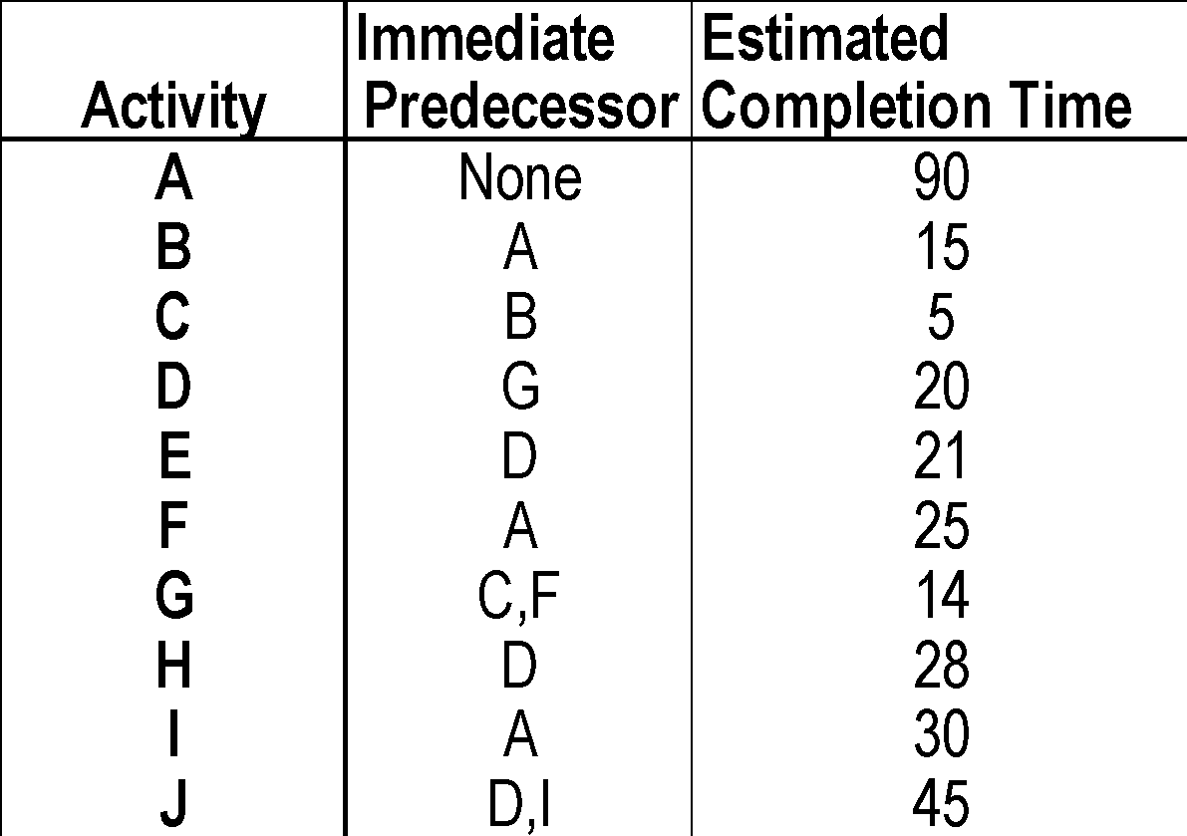
KLONE COMPUTERS, INC
Precedence Relationships Chart
‹#›
Notes:
‹#›

Slide 11
5.3 The PERT/CPM Approach for Project Scheduling
The PERT/CPM approach to project scheduling uses network presentation of the project to
Reflect activity precedence relations
Activity completion time
PERT/CPM is used for scheduling activities such that the project’s completion time is minimized.
‹#›
Notes:
‹#›

Slide 12
KLONE COMPUTERS, INC. - Continued
Management at KLONE would like to schedule the activities so that the project is completed in minimal time.
Management wishes to know:
The earliest and latest start times for each activity which will not alter the earliest completion time of the project.
The earliest finish times for each activity which will not alter this date.
Activities with rigid schedule and activities that have slack in their schedules.
‹#›
Notes:
‹#›

Slide 13
Earliest Start Time / Earliest Finish Time
Make a forward pass through the network as follows:
Evaluate all the activities which have no immediate predecessors.
The earliest start for such an activity is zero ES = 0.
The earliest finish is the activity duration EF = Activity duration.
Evaluate the ES of all the nodes for which EF of all the immediate predecessor has been determined.
ES = Max EF of all its immediate predecessors.
EF = ES + Activity duration.
Repeat this process until all nodes have been evaluated
EF of the finish node is the earliest finish time of the project.
‹#›
Notes:
‹#›

Slide 14
Earliest Start / Earliest Finish – Forward Pass
90,105
105,110
170
149,170
B
C
E
B
15
C
5
E
21
110,124
0,90
90,115
177
115,129
129,149
149,177
F
G
H
F
25
G
14
D
20
H
28
A
D
194
A
90
EARLIEST FINISH
120,165
194
90,120
149,194
J
I
J
45
I
30
‹#›

Slide 15
Latest start time / Latest finish time
Make a backward pass through the network as follows:
Evaluate all the activities that immediately precede the finish node.
The latest finish for such an activity is LF = minimal project completion time.
The latest start for such an activity is LS = LF - activity duration.
Evaluate the LF of all the nodes for which LS of all the immediate successors has been determined.
LF = Min LS of all its immediate successors.
LS = LF - Activity duration.
Repeat this process backward until all nodes have been evaluated.
‹#›
Notes:
‹#›

Slide 16
Latest Start / Latest Finish – Backward Pass
149,170
90,105
105,110
173,194
E
21
B
E
B
15
C
C
5
110,115
95,110
90,115
115,129
129,149
149,177
90, 115
115,129
129,149
5,95
153,173
166,194
0,90
129,149
F
129,149
146,166
F
25
D
D
20
H
G
H
28
A
0,90
G
14
129,149
A
90
129,149
194
129,149
129,149
129,149
129,149
29,119
149,194
90,120
149,194
119,149
J
I
J
45
I
30
‹#›
Notes:
‹#›

Slide 17
Slack Times
Activity start time and completion time may be delayed by planned reasons as well as by unforeseen reasons.
Some of these delays may affect the overall completion date.
To learn about the effects of these delays, we calculate the slack time, and form the critical path.
‹#›
Notes:
‹#›

Slide 18
Slack Times
Slack time is the amount of time an activity can be delayed without delaying the project completion date, assuming no other delays are taking place in the project.
Slack Time = LS - ES = LF - EF
‹#›
Notes:
‹#›

Slide 19
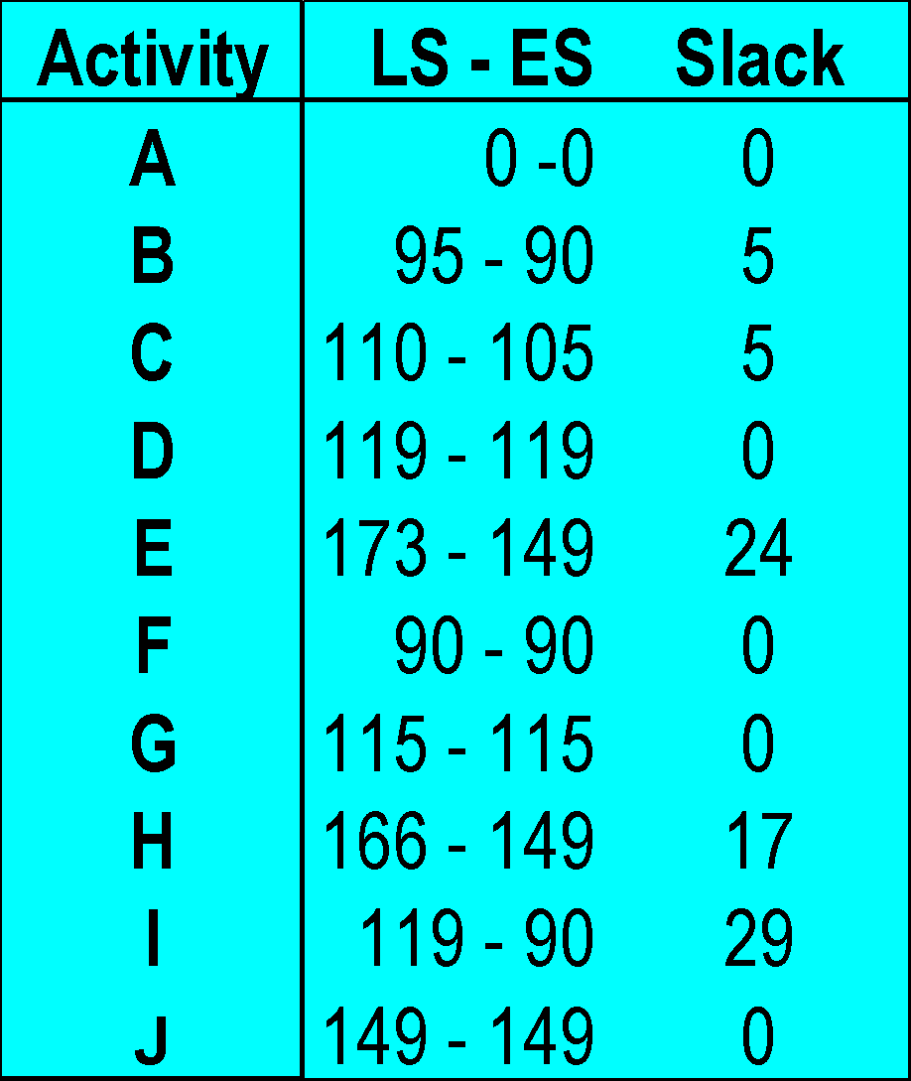
Slack time in the Klonepalm 2000 Project
Critical activities
must be rigidly
scheduled
‹#›
Notes:
‹#›

Slide 20
The Critical Path
The critical path is a set of activities that have no slack, connecting the START node with the FINISH node.
The critical activities (activities with 0 slack) form at least one critical path in the network.
A critical path is the longest path in the network.
The sum of the completion times for the activities on the critical path is the minimal completion time of the project.
‹#›
Notes:
‹#›

Slide 21
The Critical Path
90,105
105,110
149,170
E
21
B
E
B
15
C
95,110
C
5
110,115
173,194
0,90
90,115
115,129
129,149
149,177
0,90
90, 115
115,129
129,149
166,194
F
F
25
D
D
20
H
G
H
28
A
G
14
A
90
149,194
90,120
149,194
119,149
J
I
J
45
I
30
‹#›
Notes:
‹#›

Slide 22
Possible Delays
We observe two different types of delays:
Single delays.
Multiple delays.
Under certain conditions the overall project completion time will be delayed.
The conditions that specify each case are presented next.
‹#›
Notes:
‹#›

Slide 23
Single delays
A delay of a certain amount in a critical activity, causes the entire project to be delayed by the same amount.
A delay of a certain amount in a non-critical activity will delay the project by the amount the delay exceeds the slack time. When the delay is less than the slack, the entire project is not delayed.
‹#›
Notes:
‹#›

Slide 24
Multiple delays of non critical activities: Case 1: Activities on different paths
ES=149
DELAYED START=149+15=164
B
15
C
5
LS=173
E
21
A
90
F
25
G
14
D
20
H
28
FINISH
Activity E and I are each delayed 15 days.
THE PROJECT COMPLETION TIME IS NOT DELAYED
I
30
J
45
ES=90
DELAYED START=90+15 =105
LS =119
‹#›
Notes:
‹#›

Slide 25
90
105
90
115
A
15
129
B
5
194
149
C
20
D
194
Gantt chart demonstration of the (no) effects on the project
completion time when delaying
activity “I” and “E” by 15 days.
21
E
25
Activity E
F
14
G
28
H
30
I
Activity I
45
J
‹#›
Notes:
‹#›

Slide 26
Multiple delays of non critical activities: Case 2: Activities are on the same path, separated by critical activities.
ES=90
ES=149
DELAYED START =94
DELAYED START=149+15 =164
LS =95
LS =173
B
C
E
15
5
21
A
F
G
D
H
FINISH
90
25
14
20
28
Activity B is delayed 4 days, activity E is delayed 15 days
THE PROJECT COMPLETION TIME IS NOT DELAYED
I
J
45
30
‹#›
Notes:
‹#›

Slide 27
Multiple delays of non critical activities: Case 2: Activities are on the same path, no critical activities separating them.
ES= 90
3 DAYS DELAY
IN THE ENTIRE
PROJECT
DELAYED START =94
DELAYED FINISH =
DELAYED START=
94+15=109
109 + 4 =113;
B
LS =110
C
E
15
5
21
A
F
G
D
H
FINISH
90
25
14
20
28
Activity B is delayed 4 days; Activity C is delayed 4 days.
THE PROJECT COMPLETION TIME IS DELAYED 3 DAYS
I
J
45
30
‹#›
Notes:
‹#›

Slide 28
5.4 A Linear Programming Approach to PERT/CPM
Variables
X_{i} = The start time of the activities for i=A, B, C, …,J
X(FIN) = Finish time of the project
Objective function
Complete the project in minimum time.
Constraints
For each arc a constraint states that the start time of M must not occur before the finish time of its immediate predecessor, L.
L
M
‹#›
Notes:
‹#›

Slide 29
A Linear Programming Approach
Define X(FIN) to be the finish time of the project.
The objective then is
Minimize X(FIN)
While this objective function is intuitive
other objective functions provide more
information, and are presented later.
‹#›
Notes:
‹#›

Slide 30
A Linear Programming Approach
Minimize X(FIN)
ST
C
5
X(FIN) ≥ X_{E} + 21
X(FIN) ≥ X_{H} + 28
X(FIN) ≥ X_{J} + 45
X_{D} ≥ X_{G} + 14
X_{E} ≥ X_{D} + 20 X_{G} ≥ X_{C}+ 5
X_{H} ≥ X_{D} + 20 X_{G} ≥ X_{F}+ 25
X_{J} ≥ X_{D} + 20 X_{I} ≥ X_{D}+ 90
X_{J} ≥ X_{I} + 30 X_{F} ≥ X_{A}+ 90
X_{C} ≥ X_{B}+ 15
X_{D} ≥ X_{G}+ 14
X_{B} ≥ X_{A}+ 90
F
25
G
All X s are nonnegative
‹#›
Notes:
‹#›

Slide 31
A Linear Programming Approach
Minimize X_{A}+X_{B}+…+X_{J} This objective function ensures that the optimal X values are the earliest start times of all the activities. The project completion time is minimized.
Maximize X_{A}+X_{B}+…+X_{J}
S.T. X(FIN) = 194 and all the other constraints as before. This objective function and the additional constraint ensure that the optimal X values are
the latest start times of all the activities.
‹#›
Notes:
‹#›

Slide 32
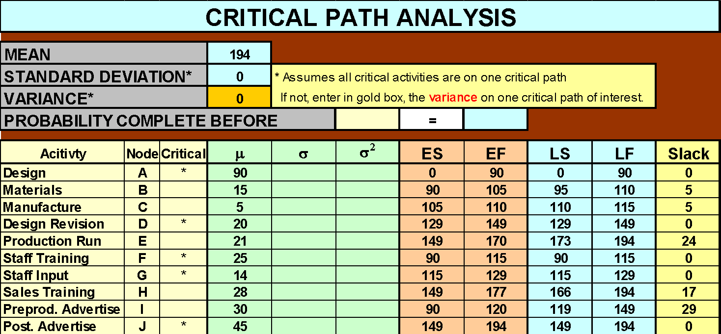
5.5 Obtaining Results Using Excel
‹#›

Slide 33
5.6 Gantt Charts
Gantt charts are used as a tool to monitor and control the project progress.
A Gantt Chart is a graphical presentation that displays activities as follows:
Time is measured on the horizontal axis. A horizontal bar is drawn proportionately to an activity’ s expected completion time.
Each activity is listed on the vertical axis.
In an earliest time Gantt chart each bar begins and ends at the earliest start/finish the activity can take place.
‹#›
Notes:
‹#›

Slide 34
Here‘s how we build an Earliest Time Gantt Chart for KLONEPALM 2000
‹#›

Slide 35
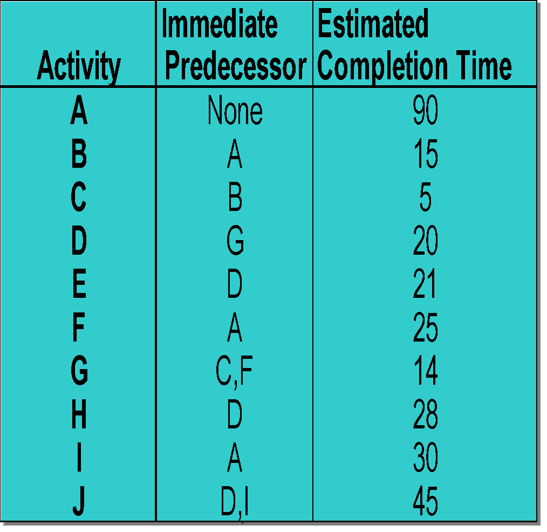
90
105
90
115
A
15
129
B
5
149
194
C
20
D
194
21
E
25
F
14
G
28
H
30
I
45
J
‹#›
Notes:
‹#›

Slide 36
Gantt Charts- Monitoring Project Progress
Gantt chart can be used as a visual aid for tracking the progress of project activities.
Appropriate percentage of a bar is shaded to document the completed work.
The manager can easily see if the project is progressing on schedule (with respect to the earliest possible completion times).
‹#›
Notes:
‹#›

Slide 37
Monitoring Project Progress
90
A
15
B
5
194
C
20
The shaded bars represent
completed work BY DAY 135.
D
194
21
E
25
F
14
G
28
Do not conclude that the
project is behind schedule.
H
30
I
45
Activity “I” has a slack and
therefore can be delayed!!!
J
135
‹#›
Notes:
‹#›

Slide 38
Gantt Charts – Advantages and Disadvantages
Advantages.
Easy to construct
Gives earliest completion date.
Provides a schedule of earliest possible start and finish times of activities.
Disadvantages
Gives only one possible schedule (earliest).
Does not show whether the project is behind schedule.
Does not demonstrate the effects of delays in any one activity on the start of another activity, thus on the project completion time.
‹#›
Notes:
‹#›

Slide 39
5.7 Resource Leveling and Resource Allocation
It is desired that resources are evenly spread out throughout the life of the project.
Resource leveling methods (usually heuristics) are designed to:
Control resource requirements
Generate relatively similar usage of resources over time.
‹#›
Notes:
‹#›

Slide 40
Resource Leveling – A Heuristic
A heuristic approach to “level” expenditures
Assumptions
Once an activity has started it is worked on continuously until it is completed.
Costs can be allocated equally throughout an activity duration.
Step 1: Consider the schedule that begins each activity at its ES.
Step 2: Determine which activity has slack at periods of peak
spending.
Step 3: Attempt to reschedule the non-critical activities performed
during these peak periods to periods of less spending, but
within the time period between their ES and LF.
‹#›
Notes:
‹#›

Slide 41
Resource Leveling – KLONE COMPUTERS, Inc. - continued
Management wishes to schedule the project such that
Completion time is 194 days.
Daily expenditures are kept as constant as possible.
To perform this analysis cost estimates for each activity will be needed.
‹#›
Notes:
‹#›

Slide 42
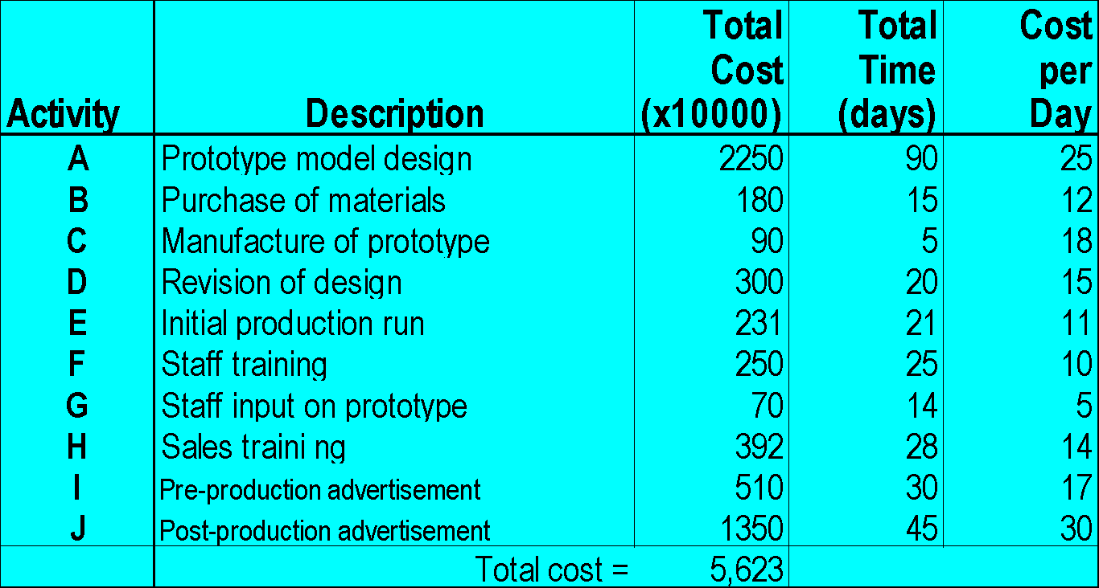
Resource Leveling – KLONE COMPUTERS, Inc. – cost estimates
‹#›
Notes:
‹#›

Slide 43
Cumulative Daily Expenditure – Earliest Times vs. Latest Times
55
50
45
40
35
30
25
20
15
10
5
Earliest Start-Earliest Finish
Budget
Feasible
Budgets
Level Budget
Latest Start-Latest Finish
Budget
Time
‹#›
20 40 60 80 100 120 140 160 180 200
Notes:
‹#›

Slide 44
Daily Expenditure of the ES Schedule
55
50
45
40
35
30
25
20
15
10
5
55
Cost Leveling
H
E
J
I
I
I
I
I
I
I
H
ES = 90
45
LS = 110
44
I
I
39
E
J
E
H
J
I
I
H
J
32
30
27
I
25
I
F
C
F
22
I
J
15
B
F
D
A
G
‹#›
20 40 60 80 100 120 140 160 180 200
Notes:
‹#›

Slide 45
Cost Leveling
55
50
45
40
35
30
25
20
15
10
5
55
H
E
J
H
44
I
E
J
E
H
J
I
H
J
H
32
30
27
I
25
I
F
C
F
22
I
J
15
B
F
D
A
G
‹#›
20 40 60 80 100 120 140 160 180 200
Notes:
‹#›

Slide 46
5.8 The Probability Approach to Project Scheduling
Activity completion times are seldom known with 100% accuracy.
PERT is a technique that treats activity completion times as random variables.
Completion time estimates are obtained by the Three Time Estimate approach
‹#›
Notes:
‹#›

Slide 47
The Probability Approach – Three Time Estimates
The Three Time Estimate approach provides completion time estimate for each activity.
We use the notation: a = an optimistic time to perform the activity.
m = the most likely time to perform the activity.
b = a pessimistic time to perform the activity.
‹#›
Notes:
‹#›

Slide 48
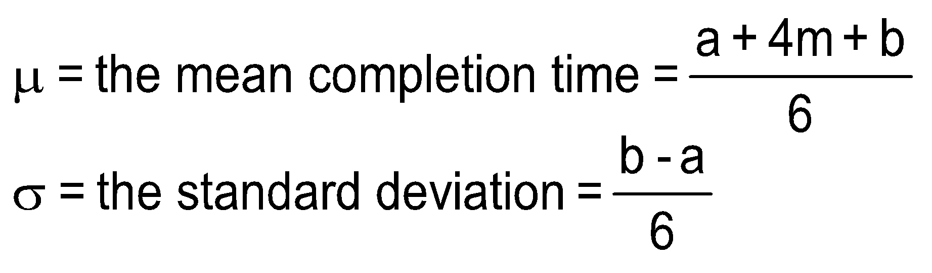
The Distribution, Mean, and Standard Deviation of an Activity
Approximations for the mean and the standard deviation of activity completion time are based on the Beta distribution.
‹#›

Slide 49
The Project Completion Time Distribution - Assumptions
To calculate the mean and standard
deviation of the project completion time
we make some simplifying assumptions.
‹#›
Notes:
‹#›

Slide 50
The Project Completion Time Distribution - Assumptions
Assumption 1
A critical path can be determined by using the mean completion times for the activities.
The project mean completion time is determined solely by the completion time of the activities on the critical path.
Assumption 2
The time to complete one activity is independent of the time to complete any other activity.
Assumption 3
There are enough activities on the critical path so that the distribution of the overall project completion time can be approximated by the normal distribution.
‹#›

Slide 51
The Project Completion Time Distribution
The three assumptions imply that the overall project completion time is normally distributed, the following parameters:
Mean = Sum of mean completion times along the critical path.
Variance = Sum of completion time variances along the critical path.
Standard deviation = √Variance
‹#›
Notes:
‹#›

Slide 52
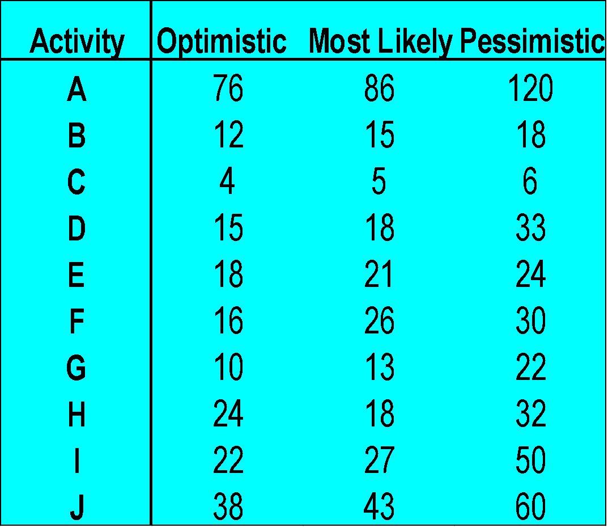
The Probability Approach – KLONE COMPUTERS
‹#›
Notes:
‹#›

Slide 53
The Probability Approach – KLONE COMPUTERS
Management at KLONE is interested in information regarding the completion time of the project.
The probabilistic nature of the completion time must be considered.
‹#›
Notes:
‹#›

Slide 54
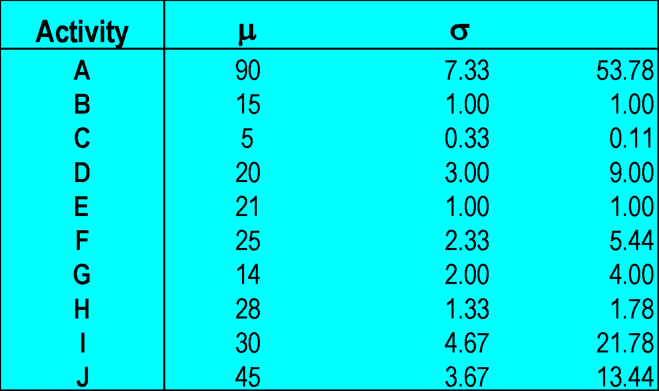
KLONE COMPUTERS – Finding activities’ mean and variance
μ_{A} = [76+4(86)+120]/6 = 90
σ_{Α} = (120 - 76)/6 = 7.33 σ_{A}² = (7.33)² = 53.78
σ²
‹#›
Notes:
‹#›

Slide 55
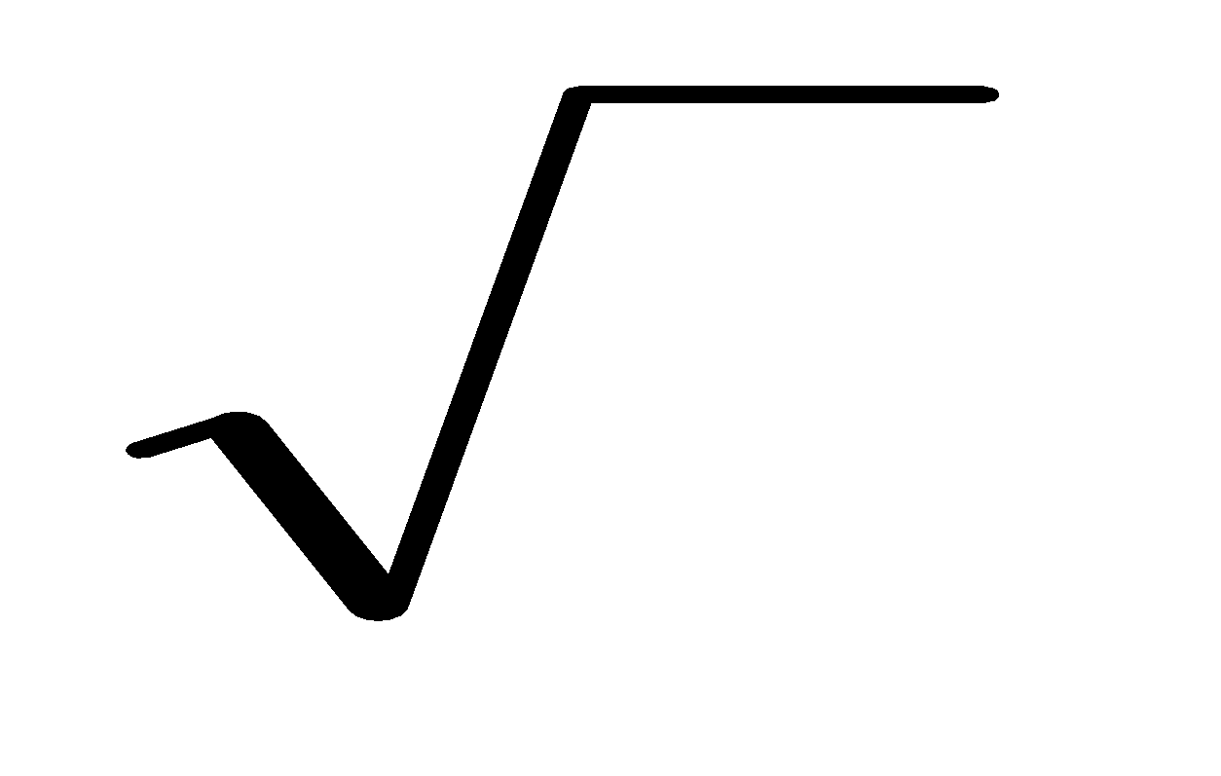
KLONE COMPUTERS – Finding mean and variance for the critical path
The mean times are the same as in the CPM problem, previously solved for KLONE.
Thus, the critical path is A - F- G - D – J.
Expected completion time = μ_{A} +μ_{F} +μ_{G} +μ_{D} +μ_{J}=194.
The project variance =σ_{A}² +σ_{F}² +σ_{G}² +σ_{D}² +σ_{J}² = 85.66
The standard deviation = = 9.255
σ²
‹#›
Notes:
‹#›

Slide 56
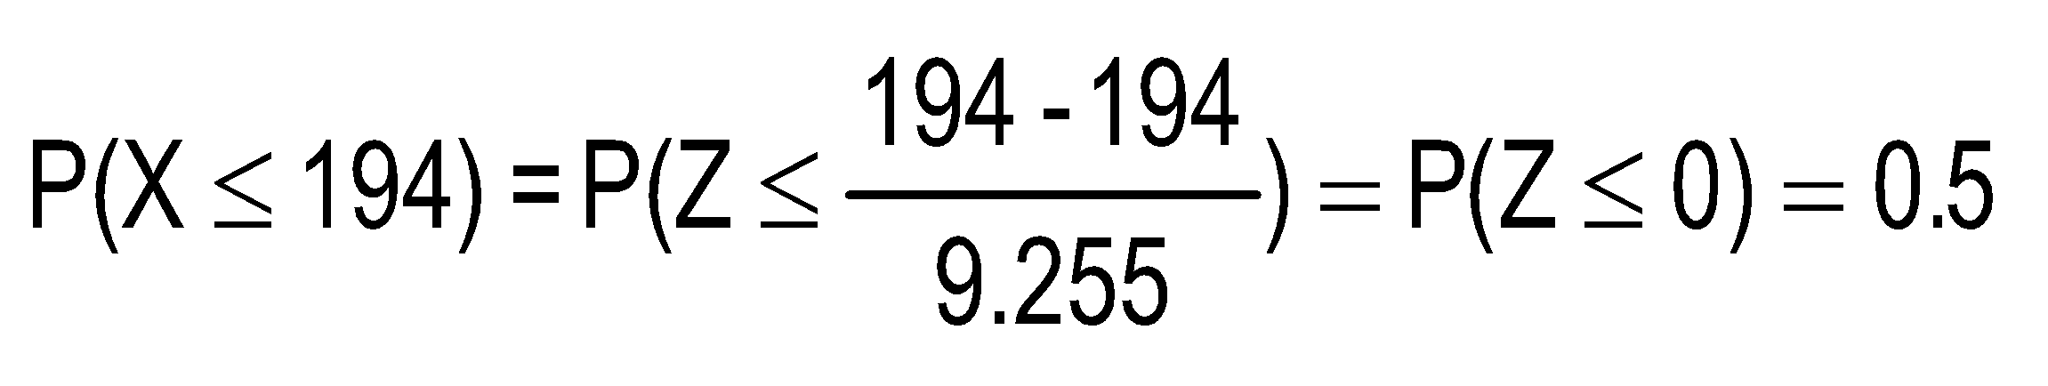
The Probability Approach – Probabilistic analysis
The probability of completion in 194 days =
194
‹#›
Notes:
‹#›

Slide 57
The Probability Approach – Probabilistic analysis
An interval in which we are reasonably sure the completion date lies is
μ
±
z
σ
0.025
.95
μ
The interval is = 194 ± 1.96(9.255) ≅ [175, 213] days.
The probability that the completion time lies in the interval [175,213] is 0.95.
‹#›
Notes:
‹#›

Slide 58
The Probability Approach – Probabilistic analysis
The probability of completion in 180 days =
0.0655
180
-1.51
194
0
X
Z
P(X ≤ 180) = P(Z ≤ -1.51) = 0.5 - 0.4345 = 0.0655
‹#›
Notes:
‹#›

Slide 59
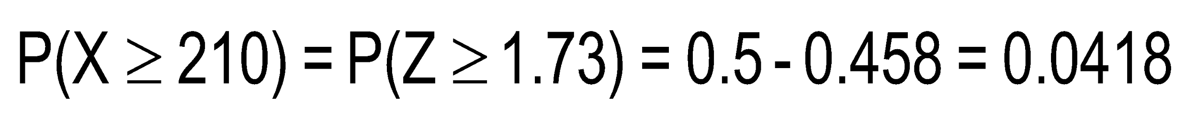
The Probability Approach – Probabilistic analysis
The probability that the completion time is longer than 210 days =
?
0.0418
.4582
194
0
210
1.73
X
Z
‹#›
Notes:
‹#›

Slide 60
The Probability Approach – Probabilistic analysis
Provide a completion time that has only 1% chance to be exceeded.
There is 99% chance that the project
is completed in 215.56 days.
.49
0.01
194
0
X₀
2.33
X
Z
P(X≥X₀) = 0.01, or P(Z ≥ [(X₀ – μ)/σ] = P(Z≥ Z₀) = .01
P(Z ≥ 2.33) = 0.01; X₀=μ+Z₀σ =194 + 2.33(9.255) = 215.56 days.
‹#›
Notes:
‹#›

Slide 61
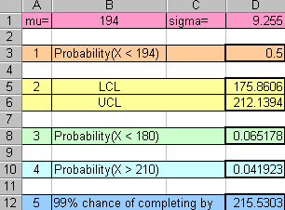
The Probability Approach – Probabilistic analysis with a spreadsheet
NORMDIST(194, 194, 9.255, TRUE)
NORMINV(.025, 194, 9.255)
NORMINV(.975, 194, 9.255)
NORMDIST(180, 194, 9.255, TRUE)
1 - NORMDIST(210, 194, 9.255, TRUE)
NORMINV(.99, 194, 9.255)
‹#›

Slide 62
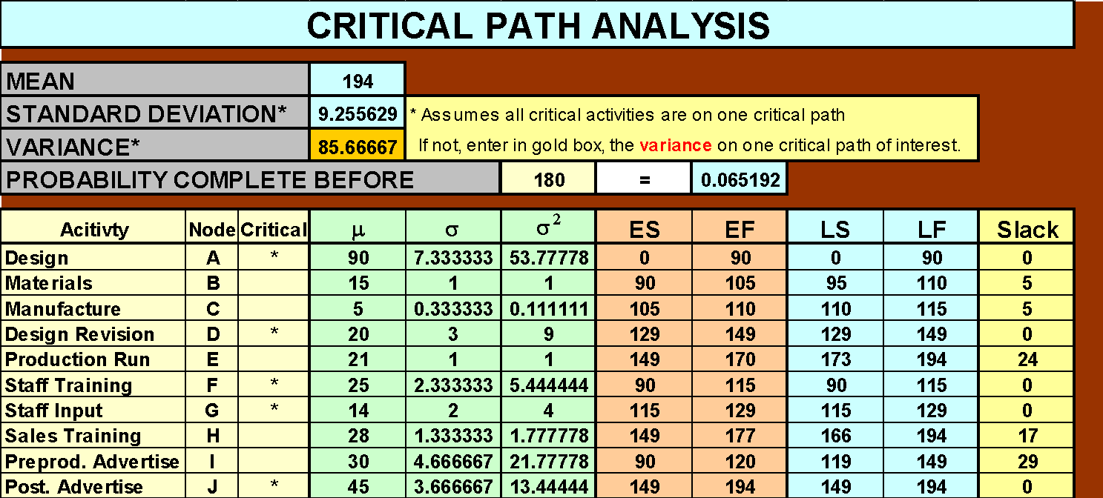
The Probability Approach – Critical path spreadsheet
‹#›

Slide 63
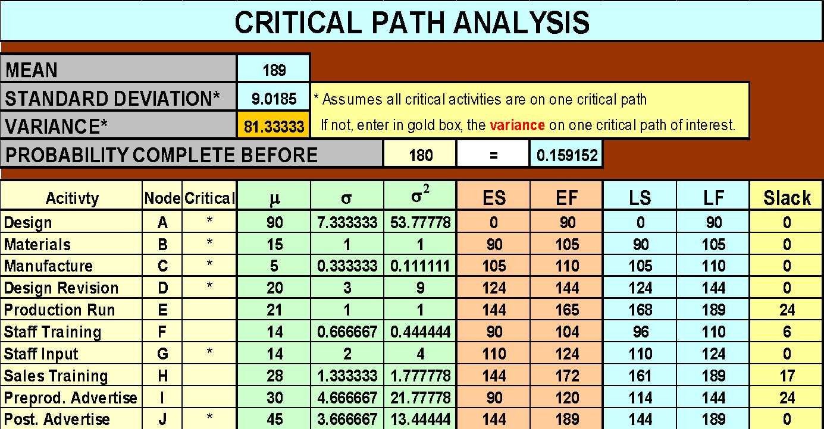
The Probability Approach – critical path spreadsheet
A comment – multiple critical paths
In the case of multiple critical paths (a not unusual situation), determine the probabilities for each critical path separately using its standard deviation.
However, the probabilities of interest (for example, P(X ≥ x)) cannot be determined by each path alone. To find these probabilities, check whether the paths are independent.
If the paths are independent (no common activities among the paths), multiply the probabilities of all the paths: [Pr(Completion time≥x) = Pr(Path 1≥x)P(Path 2≥x)…Path k≥x)]
If the paths are dependent, the calculations might become very
cumbersome, in which case running a computer simulation seems to be
more practical.
‹#›

Slide 64
5.9 Cost Analysis Using the Expected Value Approach
Spending extra money, in general should decrease project duration.
Is this operation cost effective?
The expected value criterion is used to answer this question.
‹#›
Notes:
‹#›

Slide 65
KLONE COMPUTERS - Cost analysis using probabilities
Analysis indicated:
Completion time within 180 days yields an additional profit of $1 million.
Completion time between 180 days and 200 days, yields an additional profit of $400,000.
Completion time reduction can be achieved by additional training.
‹#›
Notes:
‹#›

Slide 66
KLONE COMPUTERS - Cost analysis using probabilities
Two possible activities are considered for training.
Sales personnel training:
Cost $200,000;
New time estimates are a = 19, m= 21, and b = 23 days.
Technical staff training:
Cost $250,000;
New time estimates are a = 12, m = 14, and b = 16.
Which option should be pursued?
‹#›
Notes:
‹#›

Slide 67
KLONE COMPUTERS - Cost analysis using probabilities
Evaluation of spending on sales personnel training.
This activity (H) is not critical.
Under the assumption that the project completion time is
determined solely by critical activities, this option
should not be considered further.
Evaluation of spending on technical staff training.
This activity (F) is critical.
This option should be further studied as follows:
Calculate expected profit when not spending $250,000.
Calculate expected profit when spending $250,000.
Select the decision with a higher expected profit.
‹#›
Notes:
‹#›

Slide 68
KLONE COMPUTERS - Cost analysis using probabilities
Case 1: Do not spend $250,000 on training.
Let X represent the project’s completion time.
Expected gross additional profit = E(GP) = P(X<180)($1 million) + P(180<X<200)($400,000) + P(X>200)(0).
Use Excel to find the required probabilities: P(X<180) = .065192; P(180<X<200) = .676398; P(X>200) =.25841
Expected gross additional profit = . .065192(1M)+.676398(400K)+ .25841(0) = $335,751.20
‹#›
Notes:
‹#›

Slide 69
KLONE COMPUTERS - Cost analysis using probabilities
Case 2: Spend $250,000 on training.
The revised mean time and standard deviation estimates for activity F are:
μ_{F}= (12 + 4 (14) + 16)/6 = 14
σ_{F}= (16 -12)/6 =0.67
σ_{F}²= 0(.67)² =0.44
Using the Excel PERT-CPM template we find a new critical path (A-B-C-G-D-J), with a mean time = 189 days, and a standard deviation of = 9.0185 days.
‹#›
Notes:
‹#›

Slide 70
KLONE COMPUTERS - Cost analysis using probabilities
The probabilities of interest need to be recalculated. From Excel we find:
P(X < 180) = .159152;
P(180 < X < 200) = .729561
P(X > 200) = .111287
Expected Gross Additional Revenue = P( X<180)(1M)+P(180<X<200)(400K)+P(X>200)(0) = .159152(!M)+ .729561(400K)+ .111287(0) = $450,976.40
‹#›

Slide 71
KLONE COMPUTERS - Cost analysis using probabilities
The expected net additional profit =
450,976-250,000 = $200,976 < $335,751
Expected additional net profit when
spending $250,000 on training
Expected profit without
spending $250,000 on training
Conclusion: Management should not spend money on additional training of technical personnel.
‹#›
Notes:
‹#›

Slide 72
5.10 Cost Analyses Using The Critical Path Method (CPM)
The critical path method (CPM) is a deterministic approach to project planning.
Completion time depends only on the amount of money allocated to activities.
Reducing an activity’s completion time is called “crashing.”
‹#›
Notes:
‹#›

Slide 73
Crash time/Crash cost
There are two crucial completion times to consider for each activity.
Normal completion time (T_{N}).
Crash completion time (T_{C}), the minimum possible completion time.
The cost spent on an activity varies between
Normal cost (C_{N}). The activity is completed in T_{N}.
Crash cost (C_{C}). The activity is completed in T_{C}.
‹#›
Notes:
‹#›

Slide 74
Crash time/Crash cost – The Linearity Assumption
The maximum crashing of activity completion time is T_{C} – T_{N}.
This can be achieved when spending C_{N} – C_{C}.
Any percentage of the maximum extra cost (C_{N} – C_{C}) spent to crash an activity, yields the same percentage reduction of the maximum time savings (T_{C} – T_{N}).
‹#›
Notes:
‹#›

Slide 75
A demonstration of the Linearity Assumption
Normal
C_{N} = $2000
T_{N} = 20 days
Total Cost = $2600
Job time = 18 days
Time
20
18
16
14
12
10
8
6
4
2
…and save on
completion time
…and save more on
completion time
Add 25% of the extra
cost...
Add to the
normal cost...
Add more to the
normal cost...
… to save 25% of the
max. time reduction
Crashing
C_{C} = $4400
T_{C} = 12 days
Cost ($100)
5 10 15 20 25 30 35 40 45
‹#›
Notes:
‹#›

Slide 76
Crash time/ Crash cost - The Linearity Assumption
Marginal Cost =
Additional Cost to get Max. Time Reduction
Maximum Time reduction
= (4400 - 2000)/(20 - 12) = $300 per day
M =
E
R
‹#›

Slide 77
Crashing activities – Meeting a Deadline at Minimum Cost
If the deadline to complete a project cannot be met using normal times, additional resources must be spent on crashing activities.
The objective is to meet the deadline at minimal additional cost.
‹#›
Notes:
‹#›

Slide 78
Baja Burrito Restaurants – Meeting a Deadline at Minimum Cost
Baja Burrito (BB) is a chain of Mexican-style fast food restaurants.
It is planning to open a new restaurant in 19 weeks.
Management wants to
Study the feasibility of this plan,
Study suggestions in case the plan cannot be finished by the deadline.
‹#›
Notes:
‹#›

Slide 79
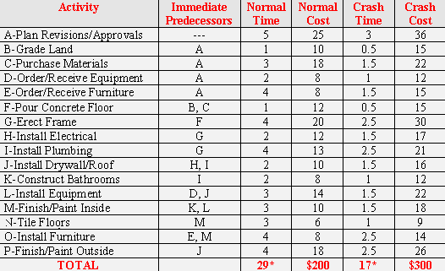
Baja Burrito Restaurants –
Without spending any extra money, the restaurant will open in 29 weeks at a normal cost of $200,000.
When all the activities are crashed
to the maximum, the restaurant
will open in 17 weeks at crash cost
of $300,000.
‹#›
Determined by the PERT.xls template

Slide 80
Baja Burrito Restaurants – Network presentation
E
O
I
K
B
A
F
G
J
M
N
C
H
P
D
L
‹#›
Notes:
‹#›

Slide 81
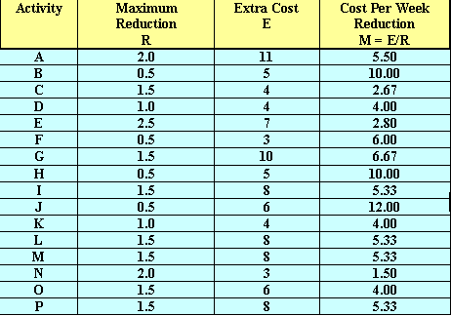
Baja Burrito Restaurants – Marginal costs
R = T_{N} – T_{C} = 5 – 3 = 2
E = C_{C} – C_{N} = 36 – 25 = 11
M = E/R = 11/2 = 5.5
‹#›
Notes:
‹#›

Slide 82
Baja Burrito Restaurants – Heuristic Solution
Small crashing problems can be solved heuristically.
Three observations lead to the heuristic.
The project completion time is reduced only when critical activity times are reduced.
The maximum time reduction for each activity is limited.
The amount of time a critical activity can be reduced before another path becomes critical is limited.
‹#›
Notes:
‹#›

Slide 83
Baja Burrito Restaurants – Linear Programming
Linear Programming Approach
Variables
X_{j} = start time for activity j.
Y_{j} = the amount of crash in activity j.
Objective Function
Minimize the total additional funds spent on crashing activities.
Constraints
No activity can be reduced more than its Max. time reduction.
Start time of an activity takes place not before the finish time of all its immediate predecessors.
The project must be completed by the deadline date D.
‹#›
Notes:
‹#›

Slide 84
Baja Burrito Restaurants – Linear Programming
Min 5.5Y_{A}+10Y_{B}+2.67Y_{C}+4Y_{D}+2.8Y_{E}+6Y_{F}+6.67Y_{G}+10Y_{H}+ 5.33Y_{I}+12Y_{J}+4Y_{K}+5.33Y_{L}+1.5Y_{N}+4Y_{O}+5.33Y_{P}
Minimize total crashing costs
‹#›
Notes:
‹#›

Slide 85
Linear Programming
Min 5.5Y_{A}+10Y_{B}+2.67Y_{C}+4Y_{D}+2.8Y_{E}+6Y_{F}+6.67Y_{G}+10Y_{H}+ 5.33Y_{I}+12Y_{J}+4Y_{K}+5.33Y_{L}+1.5Y_{N}+4Y_{O}+5.33Y_{P}
ST
X
(
)
≤
FIN
19
Y
≤
2.0
A
Meet the deadline
Y
≤
0.5
B
Y
≤
1.5
C
Maximum
time-reduction
constraints
Y
≤
1.0
D
Y
≤
2.5
E
Y
≤
0.5
F
Y _{G} 1.5
≤
Y
≤
0.5
H
……..
‹#›
Notes:
‹#›

Slide 86
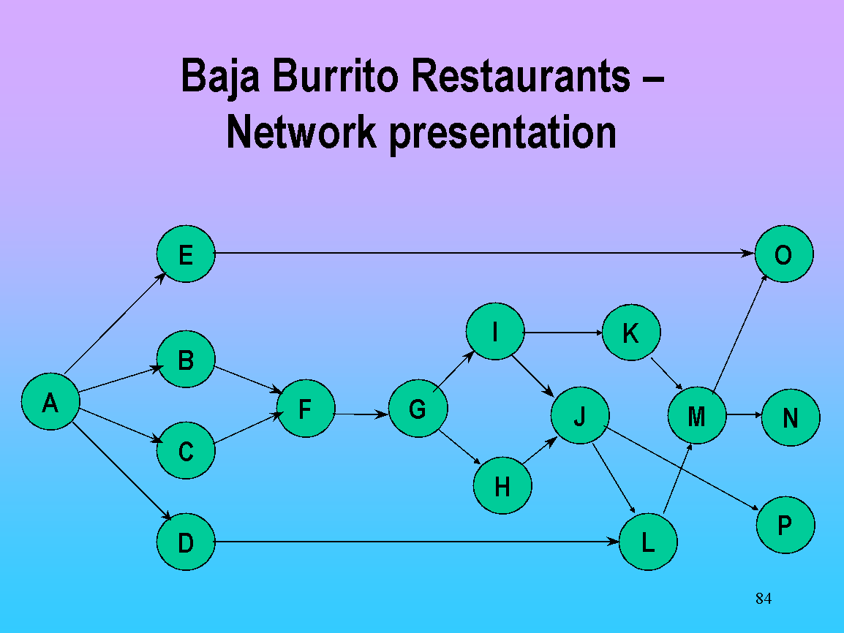
Linear Programming
Min 5.5Y_{A}+10Y_{B}+2.67Y_{C}+4Y_{D}+2.8Y_{E}+6Y_{F}+6.67Y_{G}+10Y_{H}+ 5.33Y_{I}+12Y_{J}+4Y_{K}+5.33Y_{L}+1.5Y_{N}+4Y_{O}+5.33Y_{P}
X_{B}≥X_{A}+(5 – Y_{A})
-Y_{A}
A
A
X_{A}
X_{A}+5-Y_{A}
X_{A}+5
B
B
B
B
B
X_{B}
X_{B}
X_{B}
X_{B}
X_{B}
Activity can
start only after all the
Predecessors are completed.
‹#›
Notes:
‹#›

Slide 87
Linear Programming
Min 5.5Y_{A}+10Y_{B}+2.67Y_{C}+4Y_{D}+2.8Y_{E}+6Y_{F}+6.67Y_{G}+10Y_{H}+ 5.33Y_{I}+12Y_{J}+4Y_{K}+5.33Y_{L}+1.5Y_{N}+4Y_{O}+5.33Y_{P}
X_{B}≥X_{A}+(5 – Y_{A})
X_{C}≥X_{A}+(5 – Y_{A})
X_{D}≥X_{A}+(5 – Y_{A})
X_{e}≥X_{A}+(5 – Y_{A})
X_{F}≥X_{A}+(5 – Y_{A})
X_{B}≥X_{B}+(1 – Y_{B})
X_{F}≥X_{C}+(3 – Y_{C})
X_{G}≥X_{F}+(1 – Y_{F})
X(FIN)≥X_{N}+(3 – Y_{N})
X(FIN)≥X_{O}+(4 – Y_{O})
X(FIN)≥X_{P}+(4 – Y_{P})
Activity can
start only after
all the
predecessors
are completed.
……..
‹#›
Notes:
‹#›

Slide 88
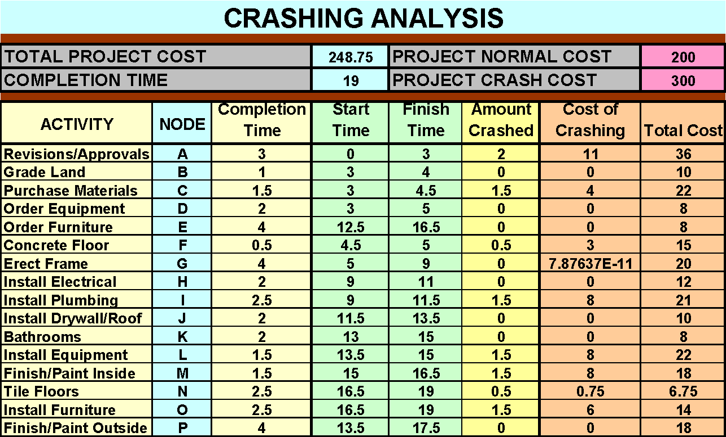
Baja Burrito Restaurants – Deadline Spreadsheet
‹#›

Slide 89
Baja Burrito Restaurants – Operating within a fixed budget
Baja Burrito has the policy of not funding more than 12.5% above the “normal cost” projection.
Crash budget = (12.5%)(200,000) = 25,000
Management wants to minimize the project completion time under the budget constraint.
‹#›
Notes:
‹#›

Slide 90
Baja Burrito Restaurants – Operating within a fixed budget
The crash funds become a constraint
Minimize
Minimize X(FIN)
5.5Y_{A} + 10Y_{B} + 2.67Y_{C} + 4Y_{D} + 2.8Y_{E} + 6Y_{F} + 6.67Y_{G} + 10Y_{H} + 5.33Y_{I} + 12Y_{J} + 4Y_{K} + 5.33Y _{L}+ 1.5Y_{N} + 4Y_{O} + 5.33Y_{P}
The completion time becomes the objective function
X(FIN) ≤ 19
5.5Y_{A} + 10Y_{B} + 2.67Y_{C} + 4Y_{D} + 2.8Y_{E} + 6Y_{F} + 6.67Y_{G} + 10Y_{H} + 5.33Y_{I} + 12Y_{J} + 4Y_{K} + 5.33Y _{L}+ 1.5Y_{N} + 4Y_{O} + 5.33Y_{P} ≤ 25
The other constraints of the crashing model remain the same.
‹#›
Notes:
‹#›

Slide 91
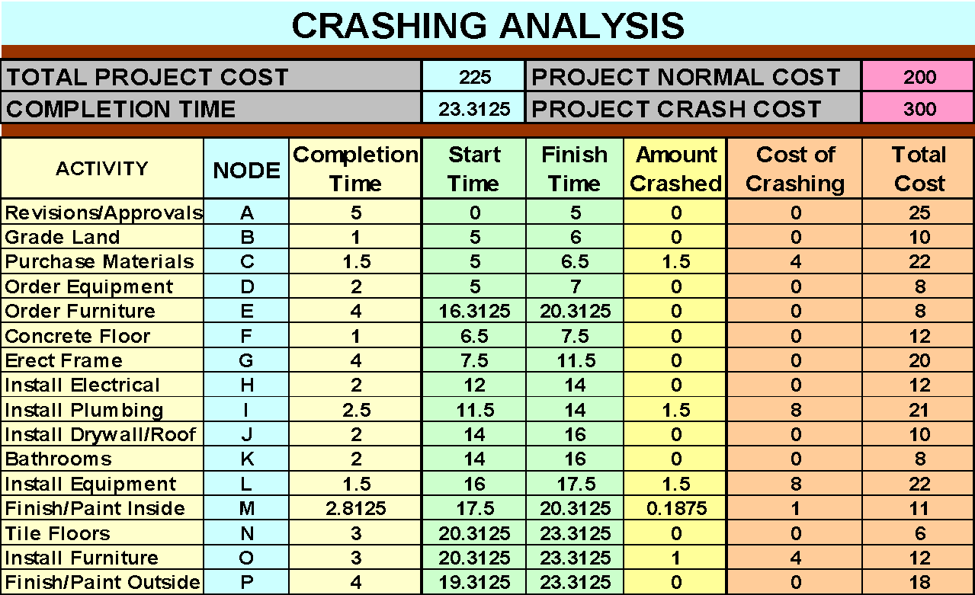
Baja Burrito Restaurants – Budget Spreadsheet
‹#›

Slide 92
7.11 PERT/COST
PERT/Cost helps management gauge progress against scheduled time and cost estimates.
PERT/Cost is based on analyzing a segmented project. Each segment is a collection of work packages.
PROJECT
Work Package 1
Activity 1
Activity 2
Work Package 3
Activity 4
Activity 6
Work Package 2
Activity 3
Activity 5
‹#›
Notes:
‹#›

Slide 93
Work Package - Assumptions
Once started, a work package is performed
continuously until it is finished.
The costs associated with a work package are spread
evenly throughout its duration.
‹#›
Notes:
‹#›

Slide 94
Monitoring Project progress
For each work package determine:
Work Package Forecasted Weekly cost = Budgeted Total Cost for Work Package
Expected Completion Time for Work Package (weeks)
Value of Work to date = p(Budget for the work package) where p is the estimated percentage of the work package completed.
Expected remaining completion time = (1 – p)(Original Expected Completion Time)
‹#›

Slide 95
Monitoring Project progress
Completion Time Analysis
Use the expected remaining completion time estimates,
to revise the project completion time.
Cost Overrun/Underrun Analysis For each work package (completed or in progress) calculate Cost overrun = [Actual Expenditures to Date] - [Value of Work to Date].
‹#›
Notes:
‹#›

Slide 96
Monitoring Project Progress – Corrective Actions
A project may be found to be behind schedule, and or experiencing cost overruns.
Management seeks out causes such as:
Mistaken project completion time and cost estimates.
Mistaken work package completion times estimates and cost estimates.
Problematic departments or contractors that cause delays.
‹#›
Notes:
‹#›

Slide 97
Monitoring Project Progress – Corrective Actions
Possible Corrective actions, to be taken whenever needed.
Focus on uncompleted activities.
Determine whether crashing activities is desirable.
In the case of cost underrun, channel more resources to problem activities.
Reduce resource allocation to non-critical activities.
‹#›
Notes:
‹#›

Slide 98
TOM LARKIN’s MAYORAL CAMPAIGN
Tom Larkin is running for Mayor.
Twenty weeks before the election the campaign remaining activities need to be assessed.
If the campaign is not on target or not within budget, recommendations for corrective actions are required.
‹#›
Notes:
‹#›

Slide 99
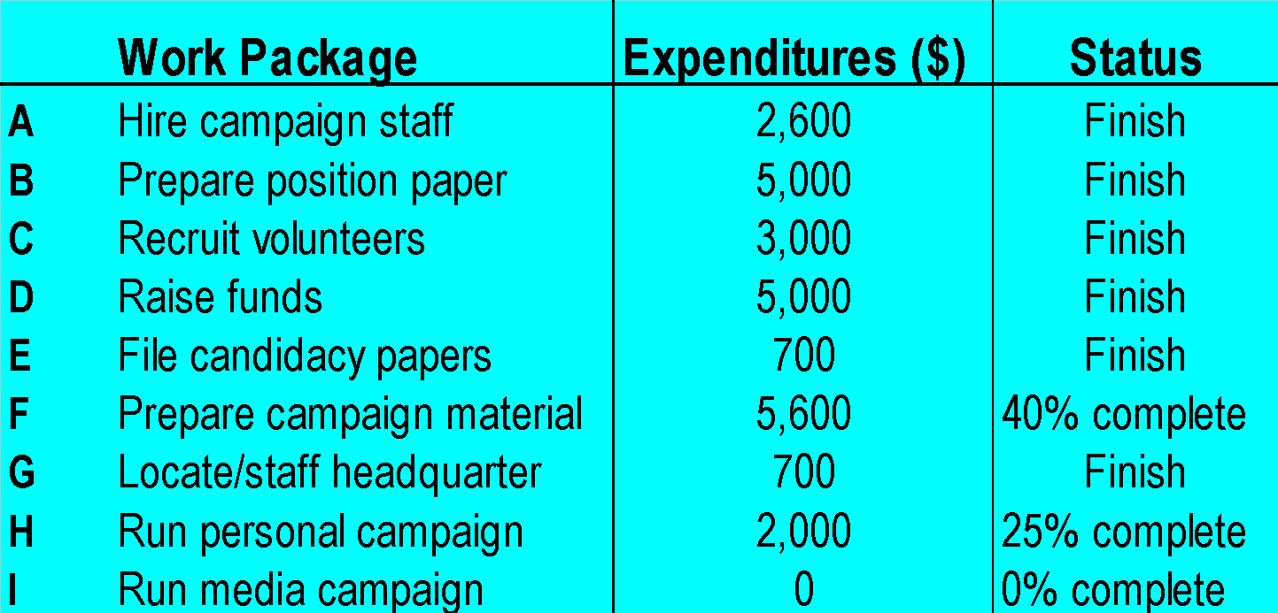
MAYORAL CAMPAIGN – Status Report
Work packages to focus on
‹#›
Notes:
‹#›

Slide 100
MAYORAL CAMPAIGN – Completion Time Analysis
The remaining network at the end of week 20.
H
15
20+15=35
Finish
(1-p)(original expected completion time)=(1-0.25)(20)=15
27.8+9=36.8
.8
I
9
F
7.8
20+7.8=27.8
The remaining activities are expected to take
0.8 weeks longer than the deadline of 36 weeks.
‹#›
Notes:
‹#›

Slide 101
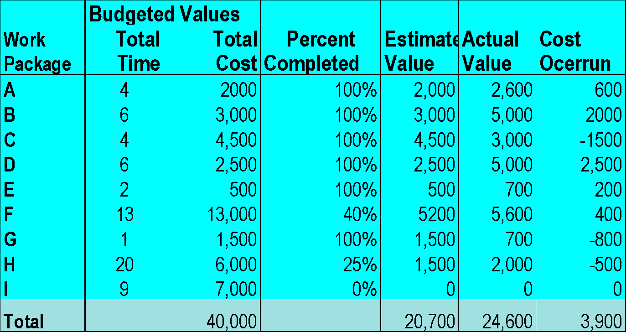
MAYORAL CAMPAIGN – Project Cost Control
Estimated work value to date=(13,000)(0.40)=$5,200
Cost overrun = 5600 - 5200 = 400
‹#›
Notes:
‹#›

Slide 102
MAYORAL CAMPAIGN – Results Summary
The project is currently .8 weeks behind schedule
There is a cost over-run of $3900.
The remaining completion time for uncompleted work packages is:
Work package F: 7.8 weeks,
Work package H: 15 weeks,
Work package I: 9 weeks.
Cost over-run is observed in
Work package F: $400,
Work package H: $500.
‹#›

Slide 103
Copyright © 2002 John Wiley & Sons, Inc. All rights reserved. Reproduction or translation of this work beyond that named in Section 117 of the United States Copyright Act without the express written consent of the copyright owner is unlawful. Requests for further information should be addressed to the Permissions Department, John Wiley & Sons, Inc. Adopters of the textbook are granted permission to make back-up copies for their own use only, to make copies for distribution to students of the course the textbook is used in, and to modify this material to best suit their instructional needs. Under no circumstances can copies be made for resale. The Publisher assumes no responsibility for errors, omissions, or damages, caused by the use of these programs or from the use of the information contained herein.
‹#›

